Slide 1
Lecture 11a: Introduction to Hadoop

Slide 2
Main Topics
Introduction to Hadoop
Versions of Hadoop
Hadoop and MapReduce
Hadoop Distributed File System (HDFS)
Hadoop Jobs
Summary

Slide 3

Introduction to Hadoop
Hadoop: open-source software for reliable, scalable, distributed computing.
Hadoop is a collection of open source software utilities that facilitate using a network of many computers to solve problems involving massive amounts of data and computation.
It provides a software framework for distributed storage and processing of big data using the MapReduce programming model.
Originally designed for computer clusters built from commodity hardware (still the common use) it has also found use on clusters of higher-end hardware.
All the modules in Hadoop are designed with a fundamental assumption that hardware failures are common occurrences and should be automatically handled by the framework.

Slide 4
History of Hadoop
In 2004 Google invented MapReduce parallel processing on high performance computing clusters.
The tasks are run on a special file system called Google File System (GFS) that is highly optimized for this purpose.
GFS is not open source.
Doug Cutting and Mike Cafarella at Yahoo! reverse engineered the GFS and called it Hadoop Distributed File System (HDFS).
The software framework that supports HDFS, MapReduce and other related entities is called the project Hadoop or simply Hadoop.
This is open source and now distributed by Apache
The Apache™ Hadoop® https://hadoop.apache.org/

Slide 5
Versions of Hadoop
Hadoop 1
Released in 2006
Hadoop 2
In 2013 Apache Hadoop 2 available.
Hadoop 3
Dec 2017, Apache Hadoop 3.0 available
Current version (as of May 2019), Apache Hadoop 3.1
Apache Hadoop 3.1 available since April 2018
Reference: https://en.wikipedia.org/wiki/Apache_Hadoop

Slide 6
Hadoop 1 vs. Hadoop 2
Figure credit to ACADGILD

Slide 7
Sl No | Hadoop1 | Hadoop2
1 | Supports MapReduce (MR) processing model only. Does not support non-MR tools | Allows to work in MR as well as other distributed computing models like Spark, Hama, Giraph, Message Passing Interface) MPI & HBase coprocessors.
2 | MR does both processing and cluster-resource management. | YARN (Yet Another Resource Negotiator) does cluster resource management and processing is done using different processing models.
3 | Has limited scaling of nodes. Limited to 4000 nodes per cluster | Has better scalability. Scalable up to 10000 nodes per cluster
4 | Works on concepts of slots – slots can run either a Map task or a Reduce task only. | Works on concepts of containers. Using containers can run generic tasks.
5 | A single Namenode to manage the entire namespace. | Multiple Namenode servers manage multiple namespaces.
6 | Has Single-Point-of-Failure (SPOF) – because of single Namenode- and in the case of Namenode failure, needs manual intervention to overcome. | Has to feature to overcome SPOF with a standby Namenode and in the case of Namenode failure, it is configured for automatic recovery.
7 | MR API is compatible with Hadoop1x. A program written in Hadoop1 executes in Hadoop1x without any additional files. | MR API requires additional files for a program written in Hadoop1x to execute in Hadoop2x.
8 | Has a limitation to serve as a platform for event processing, streaming and real-time operations. | Can serve as a platform for a wide variety of data analytics-possible to run event processing, streaming and real-time operations.
9 | A Namenode failure affects the stack. | The Hadoop stack – Hive, Pig, HBase etc. are all equipped to handle Namenode failure.
10 | Does not support Microsoft Windows | Added support for Microsoft windows
10 big differences between Hadoop 1 and Hadoop 2
Reference: https://acadgild.com/blog/10-big-differences-between-hadoop1-and-hadoop2

Slide 8
What’s new in Hadoop 3
With the 3.0 major release, Apache Hadoop continues to evolve with the addition of significant new features like HDFS erasure coding, YARN Timeline Service v2, and MapReduce task-level optimization. Together, these new features improve the performance, scalability, and multitenancy capabilities of Hadoop.
Hadoop 3 creates one parity block on every two blocks of data. This requires only 1,5 times more disk space compared with 3 times more with the replications in Hadoop 2. The level of fault tolerance in Hadoop 3 remains the same, but less disk space is required for its operations.

Slide 9
Hadoop 2 vs. Hadoop 3
Features | Hadoop 2 | Hadoop 3
Minimum Required Java Version | JDK 6 and above. | Minimum JDK 8; many dependence libraries from JDK 8 used.
Fault Tolerance | Fault Tolerance is handled through replication leading to storage and network bandwidth overhead. | Support for Erasure Coding in HDFS improves fault tolerance
Storage Scheme | Follows a 3x Replication Scheme for data recovery leading to 200% storage overhead. | Storage overhead in Hadoop 3.0 is reduced to 50% with support for Erasure Coding.
Intra DataNode Balancing | HDFS Balancer caused skew within a DataNode because of addition or replacement of disks. | Intra DataNode Balancing has been introduced to address the intra-DataNode skews which occur when disks are added or replaced.
Number of NameNodes | Hadoop 2.0 introduced a secondary namenode as standby. | Hadoop 3.0 supports 2 or more NameNodes.
… | … | …
Reference: https://www.dezyre.com/article/getting-to-know-hadoop-3-0-features-and-enhancements-/

Slide 10
Hadoop and MapReduce
MapReduce
A programming model for processing and generating large data sets with a parallel/distributed algorithm on a cluster
Hadoop
A framework for performing big data analytics
An implementation of the MapReduce paradigm
Hadoop glues the storage and analytics together and provides reliability, scalability, and management

Slide 11
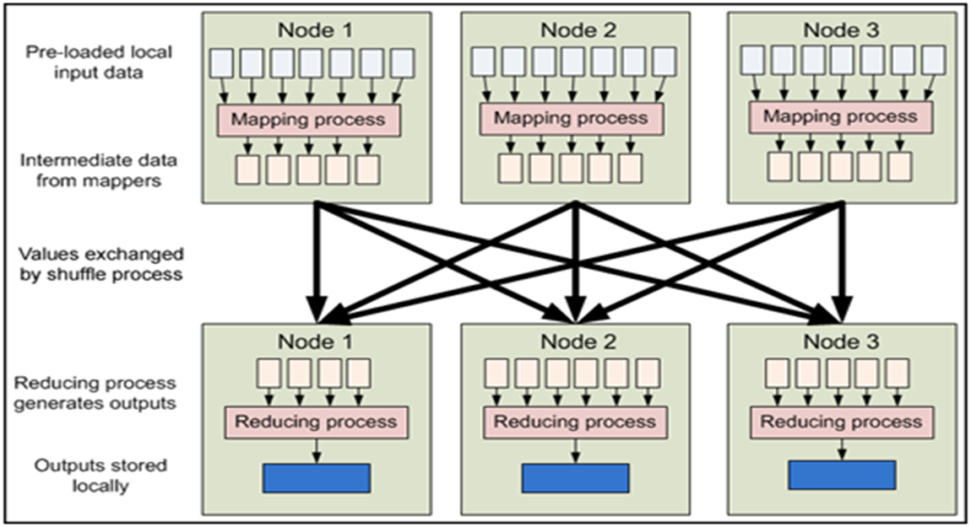
MapReduce Parallel Processing on a Cluster
https://developer.yahoo.com/hadoop/

Slide 12
HDFS: Hadoop Distributed File System
Inspired by Google’s GFS, HDFS is designed to reliably store very large files across machines in a large cluster.
Reliable, Redundant, distributed file system
Design goals
Very large files
Streaming data access
Commodity hardware
Optimized for
Highly fault-tolerant
High throughput
Streaming access to file system data
HDFS core principles are the same in both major releases of Hadoop.

Slide 13
Hadoop Architecture: Master/Slave
Hadoop supports different node types
a node is a particular machine on the network
Usually use one NameNode and multiple DataNode
Hadoop 2 may have 2 NameNodes and Hadoop 3 may have multiple NameNodes
Namenode
a master server that manages the file system namespace and regulates access to files by clients
DataNodes
manage storage attached to the nodes
actually stores data
HDFS exposes a file system namespace and allows user data to be stored in files
A file is split into one or more blocks and set of blocks are stored in DataNodes
serve read, write requests, performs block creation, deletion, and replication upon instruction from Namenode.

Slide 14
A View of Hadoop Distributed File System
HDFS Server
Masters: Job tracker,
Name node,
Secondary name node
HDFS Client
Application
Local file system
Block size: 2K
Slaves: Task tracker, Data Nodes
A master server on NameNode manages the file system and a number of DataNodes store the data blocks.
Block size: 128M
Replicated
http://techalpine.com/

Slide 15
HDFS Architecture and Data Replication
Replicated data blocks (here replication factor is 2, i.e. one duplicate) are stored on DataNodes.
http://techalpine.com/

Slide 16
Why Is a Block in HDFS So Large?
HDFS blocks are large compared to disk blocks, and the reason is to minimize the cost of seeks.
By making a block large enough, the time to transfer the data from the disk can be made to be significantly larger than the time to seek to the start of the block. Thus the time to transfer a large file made of multiple blocks operates at the disk transfer rate.
A quick calculation shows that if the seek time is around 10 ms, and the transfer rate is 100 MB/s, then to make the seek time 1% of the transfer time, we need to make the block size around 100 MB. The default block/chunk size is 64 MB, although many HDFS installations use 128 MB blocks.
However, each Map task in MapReduce normally operates on one block at a time, so if too few tasks (fewer than nodes in the cluster), jobs will run slower .

Slide 17
Activity #1
True or False
Hadoop is an implementation of MapReduce programming paradigm.
Hadoop is built on peer-to-peer architecture.
HDFS is a NoSQL database.

Slide 18
Hadoop Jobs – A WordCount Example
WordCount is a commonly used example to illustrate MapReduce tasks in Hadoop
WordCount: count the word frequency in a text file
Example
If a file’s content is:
The output would be:
a cat loves a dog, a dog loves a fox, a fox loves a cat.
a 6
cat 2
dog 2
fox 2
loves 3

Slide 19
Map and Reduce tasks in Java
public class WordCount {
public static class TokenizerMapper extends Mapper<Object, Text, Text, IntWritable>{
private final static IntWritable one = new IntWritable(1);
private Text word = new Text();
public void map(Object key, Text value, Context context )
throws IOException, InterruptedException {
StringTokenizer itr = new StringTokenizer(value.toString());
while (itr.hasMoreTokens()) {
word.set(itr.nextToken());
context.write(word, one); } } }
public static class IntSumReducer extends Reducer<Text,IntWritable,Text,IntWritable> { private IntWritable result = new IntWritable();
public void reduce(Text key, Iterable<IntWritable> values, Context context )
throws IOException, InterruptedException {
int sum = 0;
for (IntWritable val : values) { sum += val.get(); }
result.set(sum);
context.write(key, result); } }
For each Hadoop job, you will need to write a map task and a reduce task

Slide 20
How to Run WordCount Hadoop Jobs – Java/Linux
1. Prerequisite
a. Ensure Hadoop is installed, configure and is running.
b. Before you run a program, you must create input directory and specify output location in HDFS.
c. If you run the program again, make sure you remove the output directory first.
2. Copy Files to Namenode Filesystem
$ hdfs dfs -mkdir -p /user/hadoop/input
$ hdfs dfs -put myInput.txt /user/hadoop/input/ #here myInput.txt is the input file
3. Running Wordcount Command
$ cd $HADOOP_HOME
$ hadoop jar share/hadoop/mapreduce/hadoop-mapreduce-examples-2.6.0.jar wordcount input output
(Notes to Step 3: This command will read all files from input folder and process with mapreduce jar file. Results will be placed on output directory.)
4. First check the name of output files under the output directory
$ hdfs dfs -ls /user/hadoop/output
Then, show the content of the result file, say part-r-0000
$hdfs dfs -cat /user/hadoop/output/part-r-00000

Slide 21
Notes on Hadoop Jobs
Here we show general steps/commands for running Hadoop jobs
Check with your specific version of Hadoop as well as the system you’re using for specific commands
You may supply multiple files as input for one Hadoop job, e.g.
HadoopFile0.txt:
Hadoop is the Elephant King! A yellow and elegant thing. He never forgets Useful data, or lets An extraneous element cling!
HadoopFile1.txt:
A wonderful king is Hadoop. The elephant plays well with Sqoop. But what helps him to thrive Are Impala, and Hive, And HDFS in the group.
HadoopFile2.txt:
Hadoop is an elegant fellow. An elephant gentle and mellow. He never gets mad, Or does anything bad, Because, at his core, he is yellow.
Then use
$ hdfs dfs -put HadoopFile*.txt /user/hadoop/input/ #this will put all three text files into input directory
Now when you use $hadoop … to run the wordcount job, it will take all files in the input directory as the program input.

Slide 22
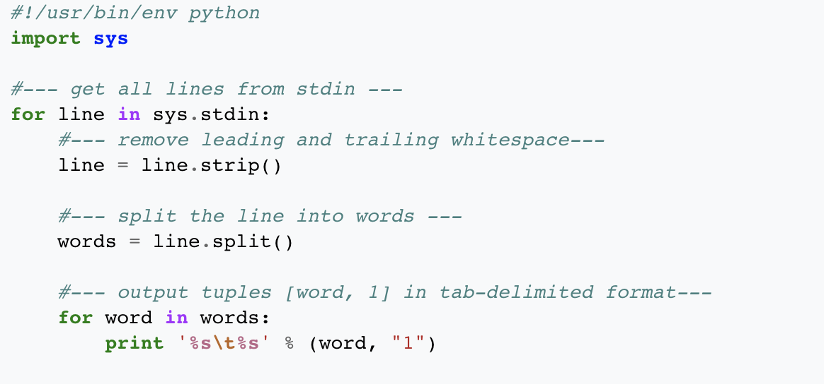
Map and Reduce Tasks in Python
#Make sure you make the #program executable:
chmod +x mapper.py
Python code: mapper.py

Slide 23
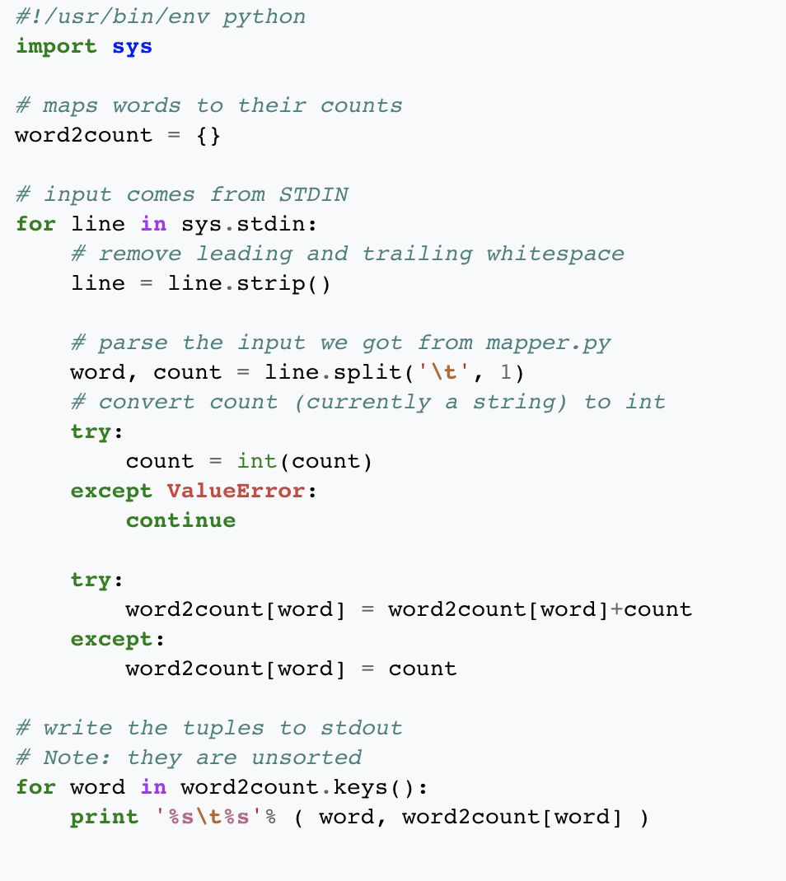
Python code: reducer.py
#Again, make the file #executable:
chmod +x reducer.py

Slide 24
How to Run Hadoop Jobs – Python/Linux
Similar to Java version
Make sure Hadoop system has been set up
Copy local example data to HDFS
Run the MapReduce job
$hadoop jar contrib/streaming/hadoop-*streaming*.jar \
-file /home/hduser/mapper.py
-mapper /home/hduser/mapper.py \
-file /home/hduser/reducer.py
-reducer /home/hduser/reducer.py \
-input /user/hduser/*
-output /user/hduser/output
4. View result at output directory
Note: commands may vary due to different system setup

Slide 25
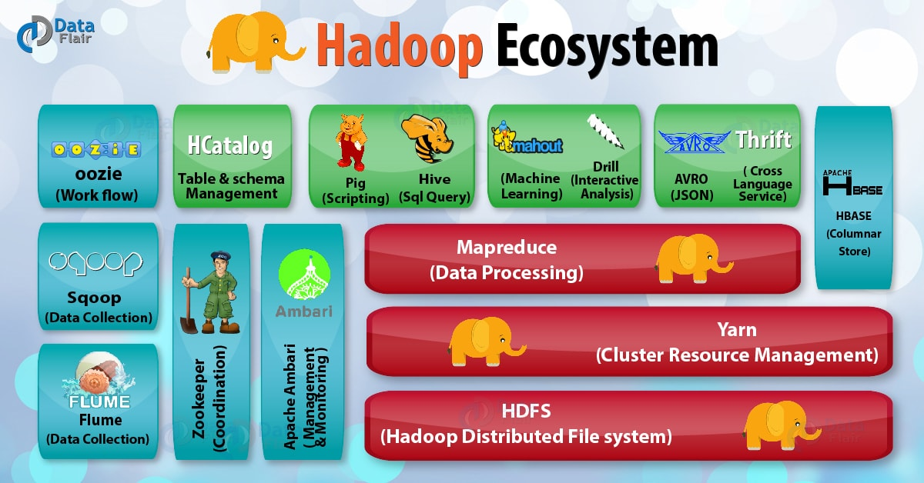

Slide 26
Summary
Hadoop is an open source software framework that implements MapReduce programming.
A WordCount example used to illustrate Hadoop jobs.
Practice (optional ?)
Introduction to XSEDE (accounts, portal login in, file transfer, …)
Run WordCount Hadoop task on XSEDE
Next Lecture: Introduction to Apache Spark

